Slide 1



Pizza Sales report
Shreesh R. Tiwari
2024

Slide 2

Introduction
Greetings! My name is Shreesh Tiwari, and I'm excited to present my project on analyzing pizza sales using SQL queries. In this project, I delve into the rich world of pizza sales data to uncover valuable insights. By leveraging SQL, I've crafted queries to address various questions pertaining to pizza sales trends, customer preferences, and more. Through meticulous analysis and query optimization, I aim to provide actionable insights that can inform strategic decisions for pizza businesses. Join me on this journey through the flavors and numbers of the pizza industry!

Slide 3

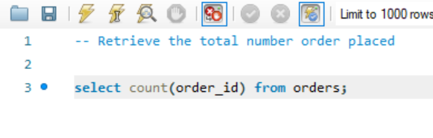
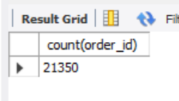
Retrieve the total number order placed

Slide 4
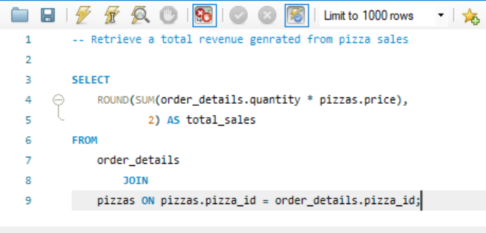
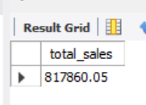
Retrieve a total revenue genrated from pizza sales

Slide 5
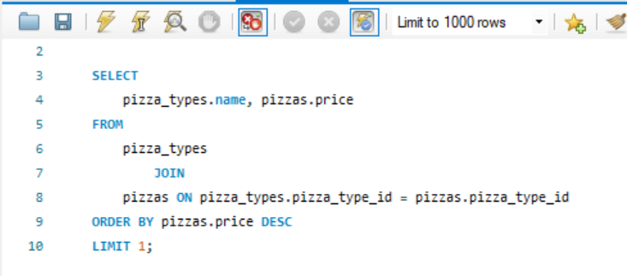
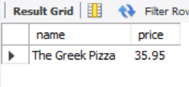
Identify the highest-priced pizza.

Slide 6
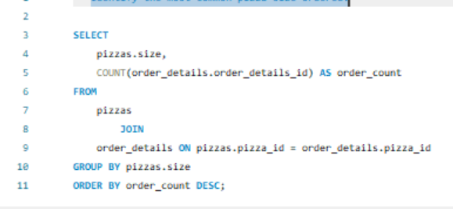
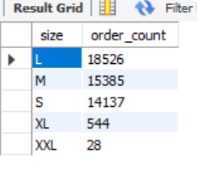
Identify the most common pizza size ordered.

Slide 7
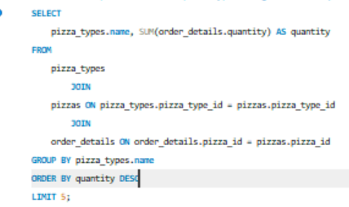
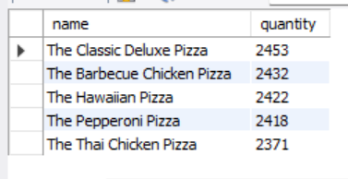
List the top 5 most ordered pizza types along with their quantities.

Slide 8
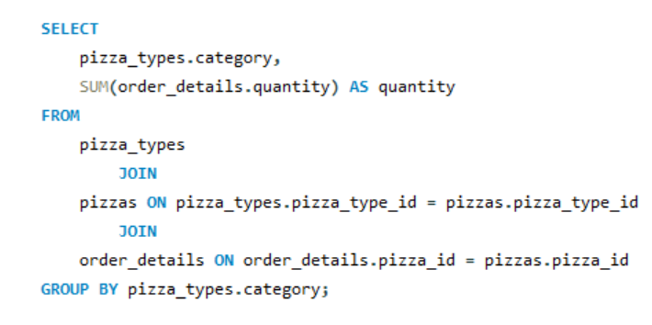
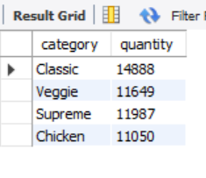
Join the necessary tables to find the total quantity of each pizza category ordered.

Slide 9
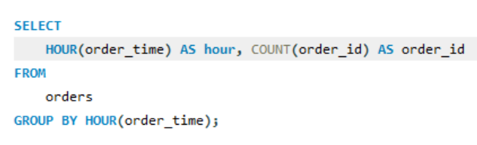
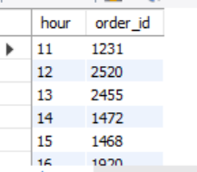
Determine the distribution of orders by hour of the day.

Slide 10

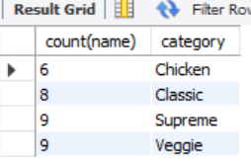
Join relevant tables to find the category-wise distribution of pizzas.

Slide 11
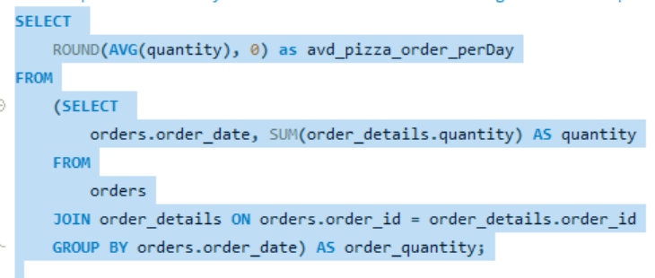

Group the orders by date and calculate the average number of pizzas ordered per day.

Slide 12
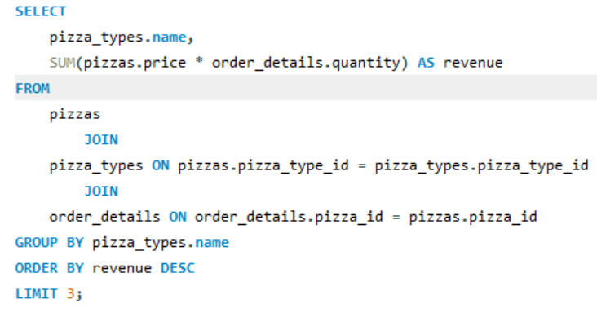
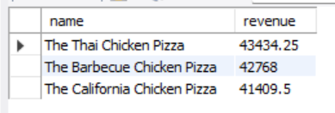
Determine the top 3 most ordered pizza types based on revenue

Slide 13
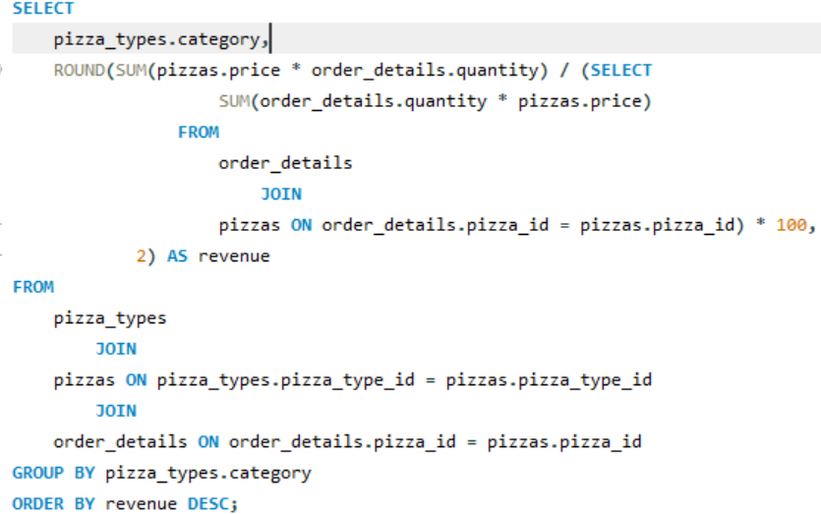
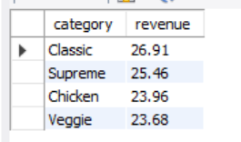
Calculate the percentage contribution of each pizza type to total revenue.

Slide 14
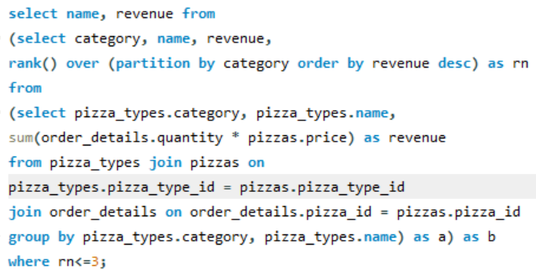
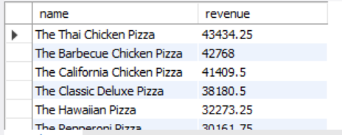
Determine the top 3 most ordered pizza types based on revenue for each pizza category.

Slide 15
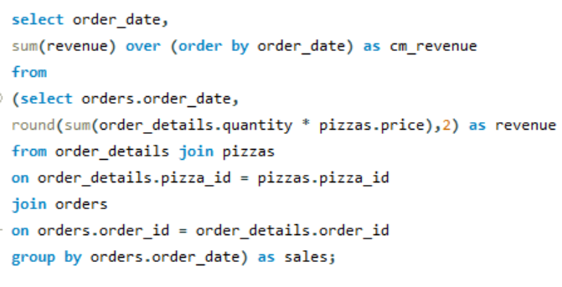
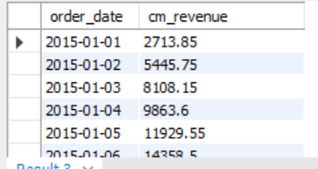
Analyze the cumulative revenue generated over time.

Slide 16
Thank You!!!

